Slide 1
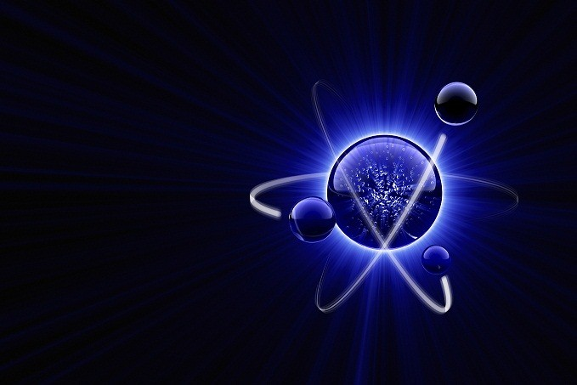
Just Blueberries (Atoms)

Slide 2
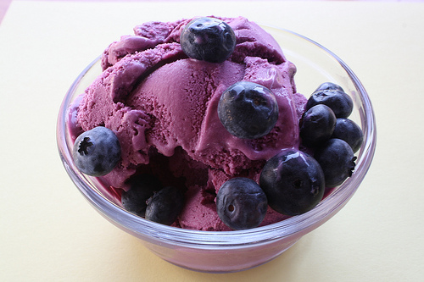
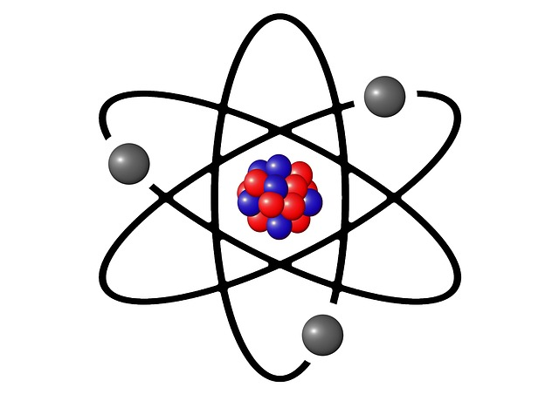
"Blueberries are essential for our health. One must never underestimate the power of the blueberries. After all, they give us an absolutely delicious ice-cream. Cats love ice-cream. Meow."
=

Slide 3
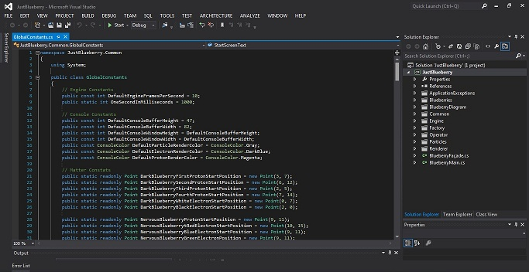
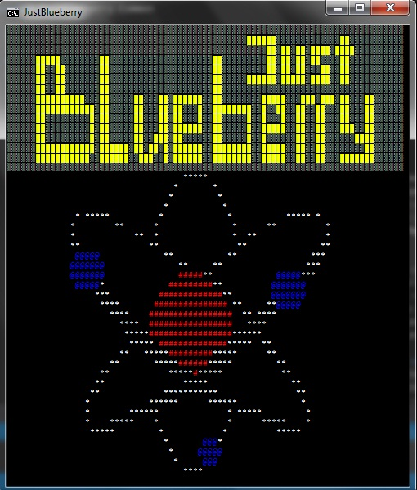
Start Screen and a bit of constants for background. Because beautiful, that’s why.

Slide 4
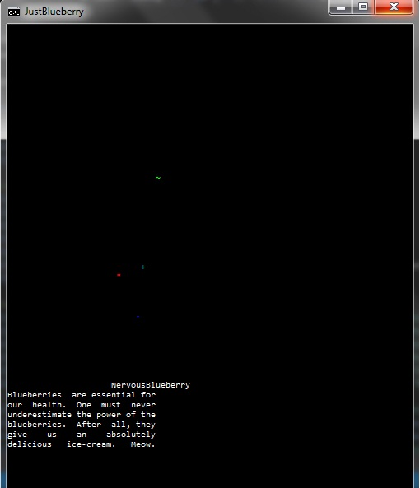
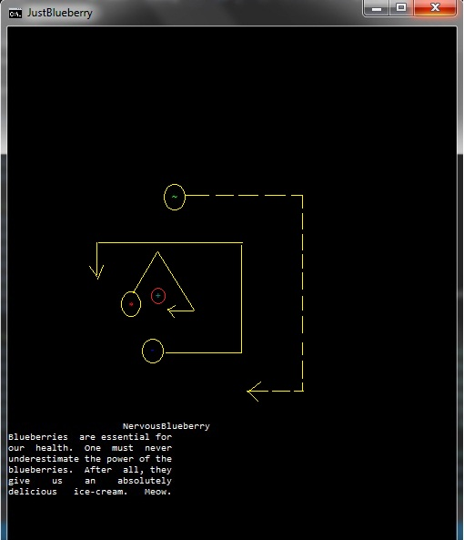
How does it work… some middle-stages pictures.

Slide 5
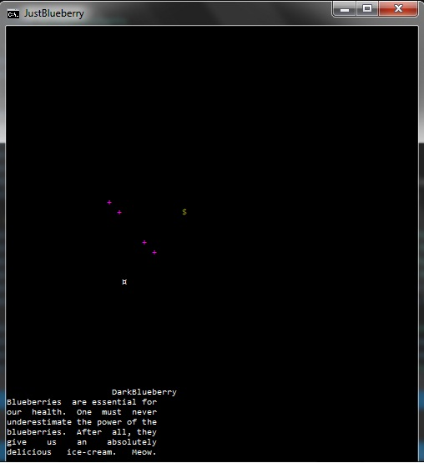
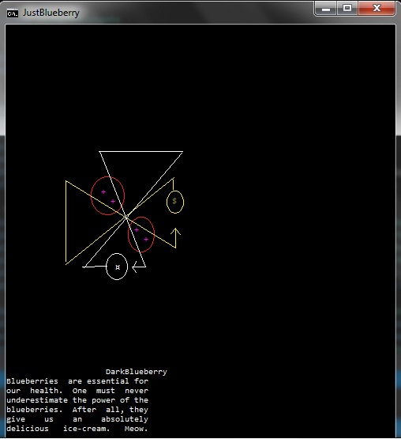

Slide 6
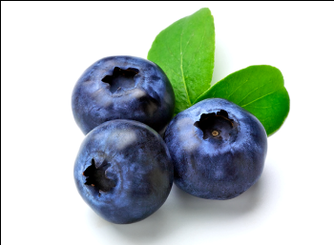
TEAM BLUEBERRY
Васил Динев
Константин Попов
Мария Качарава
Кристиян Терзиев
Александър Марков
Ивайло Петров
Илия Беличев
Димитър Гайдарджиев
Github repository

